Slide 1
SLCC’S Training Excellence Program
The Learning Center
Salt Lake Community College
Presentation at CRLA Utah Conference
June 11, 2014

Slide 2
CRLA Tutor Certification at SLCC a brief history
Process began in 1992
Collaboration between the LC, Trio/SSS, and DRC
Offered as workshops and as a credit-bearing course

Slide 3
Reasons for the Change
Tutoring locations and sizes of programs have changed.
Number of programs, and therefore, tutors seeking certification have changed.
Tutors that do not work traditional hours or on the main campus are disadvantaged.
LC was not meeting goal for ratio of certified new tutors.

Slide 4
Reasons for the Change
We are the largest tutoring department, employing over 60 tutors at five locations and online.
The LC needs more thorough training.
We need flexible, responsive, training.

Slide 5
Solution
Marry the old with something new

Slide 6
SLCC’s Tutoring Excellence Program “STEP”

Slide 7
Outline of the Series
Initial Training
Offered online in Canvas as part of the new-hire process.
Track 1
Offered Mondays from 2-4 PM at Redwood Campus during Fall and Spring Semester, plus the occasional Summer.
Sessions 1-6 (used for Level 1) are occasionally offered during summer.
Track 2
A variety of educational opportunities for tutors, which may include:
Workshops
Online work
Independent study assignments
Mentoring
And any number of other creative strategies for tutor training.
Each session will be described in an online (Canvas based) catalog as they are developed and implemented.

Slide 8
Initial Training
First Session Before You Say Anything | Before You Hit the Floor: TutorTrac, Email, Payroll
 | What Am I Doing: What is Tutoring, What is Teaching, What is Parenting
 | Basic Ethics: How to Stay Out of Trouble
 | 10 Minutes; 30 Minutes; 60 Minutes of Tutoring: How to Approach Them Differently
 | What Will They Do Next: What Should You Expect, What Should They Expect
Second Session Something to Say | Cheerleading: Praise the Process, Praise the Person
 | I’ve Never Seen This Before: Know Your Subject Material & How to Say, “I Don’t Know”
 | Cram Jam: Study Skills, Yours and Theirs
Third Session How to Say It | Tutoring Without Hands: No Pencils, No Notebook, No Textbook
 | Fishing: Questioning, Prompting, Telling, and Waiting
 | Role-play Your Life Away: Practice, Practice, Practice

Slide 9
Track 1 CRLA Tutor Certification Series & LE 1240 | Track 2 New Tutor Training & CRLA Alternative Series
Level 1
Introduction to Tutoring | Introduction to Tutoring (duplicate)
 | Definition of tutoring and tutor responsibilities
Learning Styles | Planning a Tutoring Session
Students with Disabilities | Content Areas (alternative workshops)
Study Skills | Techniques for beginning and ending a tutor session
Difficult Situations | Basic tutoring guidelines/ do’s and don’ts
Tutoring Content Areas | Active listening
 | Modeling problem solving
Level 2
Tutoring in Action (Review of Level 1)* | Tutoring in Action (duplicate)
Critical Thinking | Tutoring Nonnative English Speakers
Tips & Tricks/ESL (to be changed to diversity & gender?) | Identifying and using resources
Effective Communication Skills | Assessing student learning/study strategies
Intercultural Communication
Adult Learners | Diversity
Level 3
Not available. | Review of Level 2*, Theory of Tutoring
 | Peer Led Sessions
 | Tutoring Students with Disabilities
 | Content Area Practicum Presentation
 | Brain Based Learning
 | Online tutoring
 | Collaborative Learning and Group Study
 | Structuring the learning experience
 | Training and supervising other tutors (supervisory skills)

Slide 10
Level 1
Track 1
Maintains the Level 1 Workshop series
Maintains the Level 1 course LE 1240
Track 2
Duplicates the required first session in an online asynchronous platform
Adds all allowed CRLA training topics for Level 1
Alternative locations, times, and/or modality.

Slide 11
Track 1 CRLA Tutor Certification Series & LE 1240 | Track 2 New Tutor Training & CRLA Alternative Series
Level 1
Introduction to Tutoring | Introduction to Tutoring (duplicate)
 | Definition of tutoring and tutor responsibilities
Learning Styles | Planning a Tutoring Session
Students with Disabilities | Content Areas (alternative workshops)
Study Skills | Techniques for beginning and ending a tutor session
Difficult Situations | Basic tutoring guidelines/ do’s and don’ts
Tutoring Content Areas | Active listening
 | Modeling problem solving

Slide 12
Level 2
Track 1
Maintains the Level 2 Workshop series
Track 2
Duplicates the required first session in an online asynchronous platform
Offers variations on certain topics.
Adds all allowed CRLA training topics for Level 2
Alternative locations, times, and/or modality.

Slide 13
Track 1 CRLA Tutor Certification Series & LE 1240 | Track 2 New Tutor Training & CRLA Alternative Series
Level 2
Tutoring in Action (Review of Level 1)* | Tutoring in Action (duplicate)
Critical Thinking | Tutoring Nonnative English Speakers
Tips & Tricks/ESL (to be changed to diversity & gender?) | Identifying and using resources
Effective Communication Skills | Assessing student learning/study strategies
Intercultural Communication
Adult Learners | Diversity

Slide 14
Level 3
Track 1
does not offer Level 3
Track 2
Adds Level 3 for very experienced tutors and further opportunity for advancement
Duplicates the required first session in an online asynchronous platform
Adds all allowed CRLA training topics for Level 3

Slide 15
Track 1 CRLA Tutor Certification Series & LE 1240 | Track 2 New Tutor Training & CRLA Alternative Series
Level 3
Not available. | Review of Level 2*, Theory of Tutoring
 | Peer Led Sessions
 | Tutoring Students with Disabilities
 | Content Area Practicum Presentation
 | Brain Based Learning
 | Online tutoring
 | Collaborative Learning and Group Study
 | Structuring the learning experience
 | Training and supervising other tutors (supervisory skills)

Slide 16
Design considerations
Staffing and Standards

Slide 17
Considerations for Design
There are a lot of sessions and only a few of us.
We need content experts to help design the sessions.
The entire program needs to be codified for certification processes.
The sessions need to remain consistently designed over time.
The sessions need to be in a consistent format for certification and recertification processes.

Slide 18
Solutions: Staffing
To accomplish such a lofty goal as tackling all of these sessions and to offer them with integrity to the content, we needed a lot of good people.
English faculty
Student Writing Center
Community Writing Center
Multicultural Initiatives
Library
ESL faculty
Math faculty

Slide 19
Solutions: 3 Standards
To keep each session a consistent quality and to fit them into CRLA application processes we have a goal to maintain the following three standards:
Use consistent and concise planning strategies
Consider Universal Design for Learning
Design sessions that model Tutoring Goals

Slide 20
Standard 1: Planning Strategy
Contain an observable performance objective
Generate background knowledge
introduce the subject
generate a learning point
offer active practice
offer an activity for the comprehension check.

Slide 21
Standard 2: Universal Design for Learning
Most faculty are aware of these
Some facilitators are not teaching professionals

Slide 22
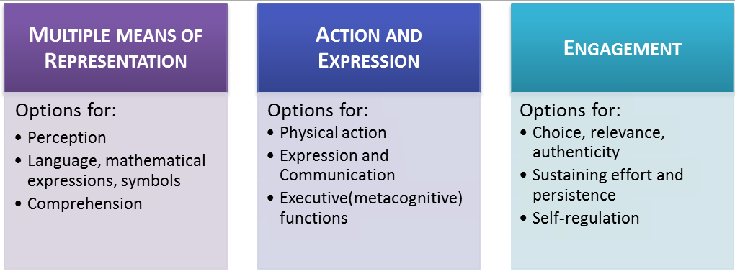
Universal Design for Learning
CSU San Marcos adapted model of UDL
http://www.csusm.edu/ids/course-design-and-instruction/designing_your_course/universal-design-for-learning.html

Slide 23
Standard 3: Model Tutoring Goals
Active learning
Motivation
Independence

