Slide 1
Planning Workshop
Reflection and Observation Essays

Slide 2
Selecting a topic
Last class you looked at pages 124-125 to choose a topic for reflection
Choose one topic now, if you haven’t already.
You will use that topic tonight.
You may choose another alternative later if you wish.

Slide 3
Topic Expansion
After you have selected a topic, you are ready to gather ideas for your reflection.
Consider the people, places and things you wish to reflect on.
Build some sort of list, free write, or graphic organizer to help you gather ideas.
Make sure you think of impacts that your topic had on yourself, others and the world.

Slide 4
Reflections: consider the impact
 | Characters | Places | Objects
Importance?
Changes to your view?
Changes to your life?
Changes in the world?

Slide 5
Sensory description of a moment
 | Sight | Smell | Hearing | Taste | Touch | Intuition
Person
Place
Object
Other

Slide 6
Connect to your Audience
What meaning does each detail hold?
Does the moment you describe relate to your audience?
Who else may have had this experience?
Have you had this experience before or since?
How can you connect your readers to your experience and the meaning you make from it?

Slide 7
Writing Observations
Choose an assignment definition from pg 186-187
Make a plan to observe more than once, or re-visit someplace (someone) you visit often to gather details.
Think about details people will care about and how your perspective will be both:
1) unique and interesting
2) unique and confusing.

Slide 8
Audience considerations
What do they already know?
What don’t they know?
What will be detail to forward your purpose and genre?
What will be detail deemed unnecessary or boring?
Considering the genre you chose, what kind of detail and voice will your audience expect?

Slide 9
How to write the details
Scientific and neutral
Personal observations
An observation for the sciences must be neutral in voice.
Reports details without bias
Though it might not report something they expect the audience to know.
A personal observation will be based on reactions and feelings.
The details should be interestingly presented and crafted for intrigue.
The audience expects certain details to be placed in the forefront over others.

Slide 10
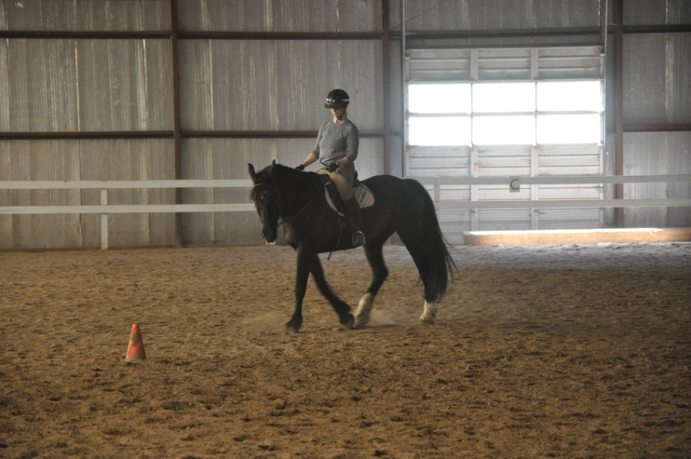
Example: Personal Observatation
Details I Observed
Every detail is recorded, but...
The dressage horse was large and black. Her mane was long but not well kept. She was a little dirty and scratched. Some other horse had bitten her chest and the wound was still healing. She moved with big floating steps. She seemed surprisingly graceful because her size made me expect her to be clumsy. Yet, if you couldn’t hear the dull thud of her dinner-plate-sized feet, I’d swear she was floating.

Slide 11
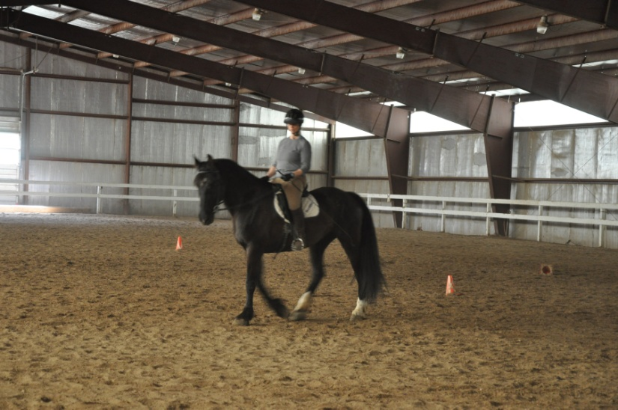
Example: Personal Observatation
Details I Observed
not every detail is needed.
The enormous black mare was not well kept. She showed signs of wear in her coat and mane; but her dressage training transformed this large, clumsy-looking beast into a graceful giantess with a floating gait. Were it not for the dull thud of her dinner-plate-sized feet, I would swear she was floating.

Slide 12
Try one now
Take a moment as a group to do the exercise on page 111 (with the modifications below).
“Write Now: Visit a Place or Event”
Get into groups of three and visit some place on campus (inside or out) right now.
Come back in 10 minutes with notes of details you observed.
Be prepared to write your observation individually in a paragraph (not 1-2 pages) and compare.
Collaborate on an opening sentences that accounts for the different perspectives.

Slide 13
Finish planning
Your planning efforts will continue at home.
When you approach each of these drafts, be cautious to distinguish the purposes and how they differ.
Remember:
A reflection is involving your audience in the significance of a past moment, item, person, place.
An observation is a current-day impression of a person, place or object as you recently viewed it.

Slide 14
Write both drafts:
Start in the middle and write to “body” first.
Work on the introduction and conclusion keeping each other in mind.
Keep your voice natural at first.
You can revise vocabulary, sentence length, and other tonal issues after you assess how your audience will receive your draft.

